Slide 1

Machine Learning
Course: Machine Learning
Supervisor: Andreas Pech
Presented by:
Tanvir Ahmed
Matriculation No. # 1386435
A S M Saiem Solimullah
Matriculation No. # 1427938

Slide 2
OBJECTIVE
The primary goal is to Test and the improvement of the FIUS sensor’s person and object detection in Horizontal Perpendicular setup.

Slide 3
TABLE OF CONTENT
INTRODUCTION
BACKGROUND
METHODOLOGY
RESULTS
CONCLUSION
REFERENCE

Slide 4
INTRODUCTION
For safety, automation and assistive tech, detecting human presence is critical.
Ultrasonic sensors are cheap, non-intrusive in nature and reliable.
This project aims to enhance human and object detection using ultrasonic echoes and machine learning.

Slide 5
BACKGROUND
Red Pitaya Based FIUS sonar sensor
Eco Detection
Fast Fourier Transform
ADC Data
Savitzky-Golay filter
Multilayer Perceptron (MLP) Classifier
Confusion Matrix

Slide 6
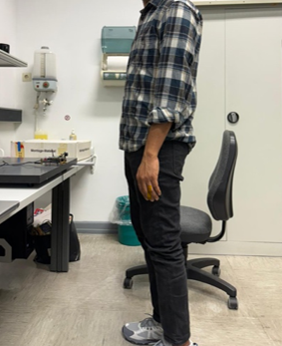
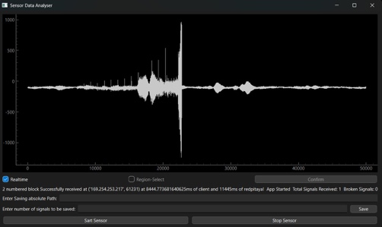
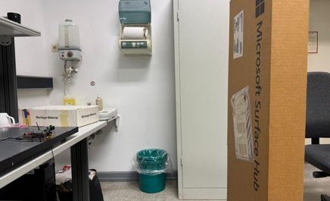
METHODOLOGY
Data Acquisition

Slide 7

METHODOLOGY
Data Preprocessing
Data Labelling
Removing Header
Remove Noisy Signal
First Eco Detection
One hat encoding of object type
ACF and Windowed Signal

Slide 8
METHODOLOGY
MLP Classifier & SVM
Feature Extraction
Combine eco index and PSD
First Eco Detection
Target Variable
Train/Test Data

Slide 9
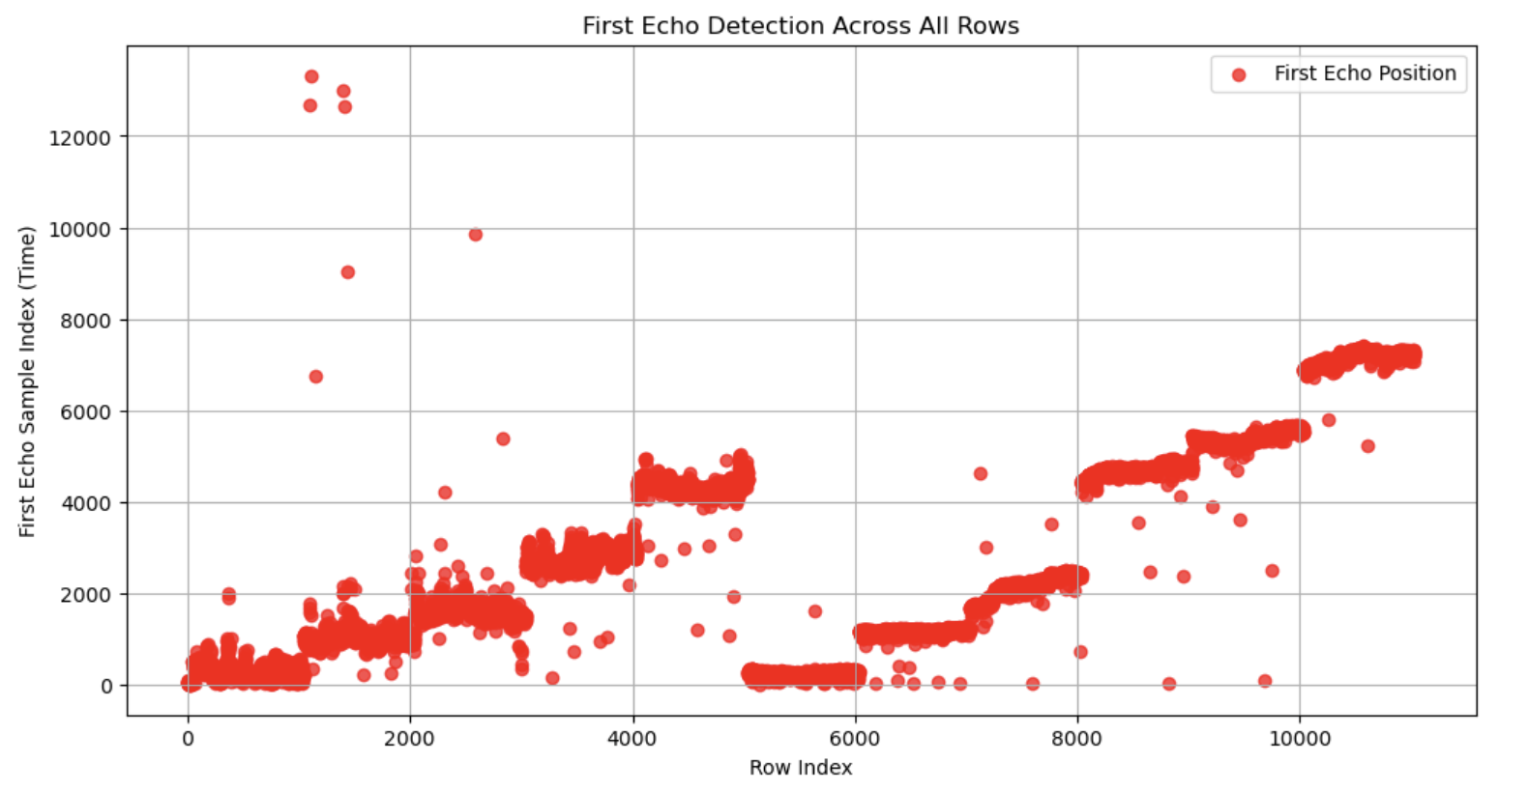
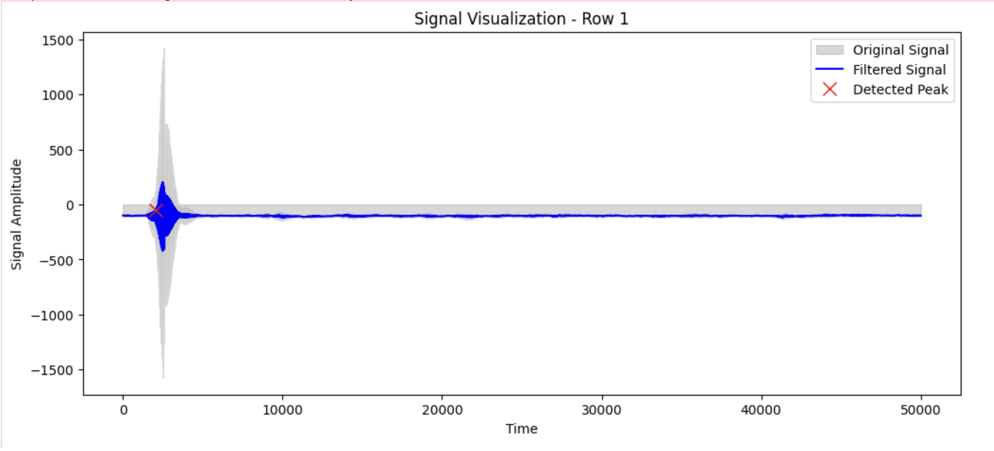
RESULTS
Data Pre-processing Output Analysis

Slide 10
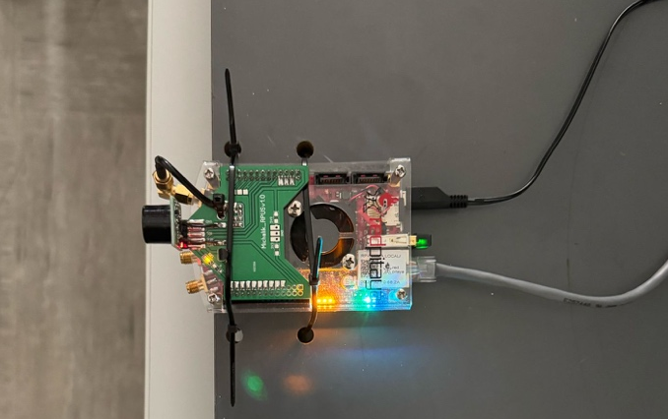
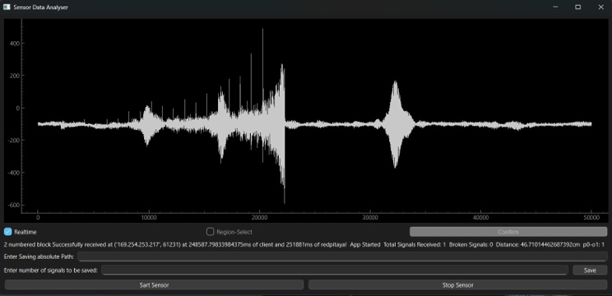
RESULTS
Distance and Person detection Model Analysis

Slide 11
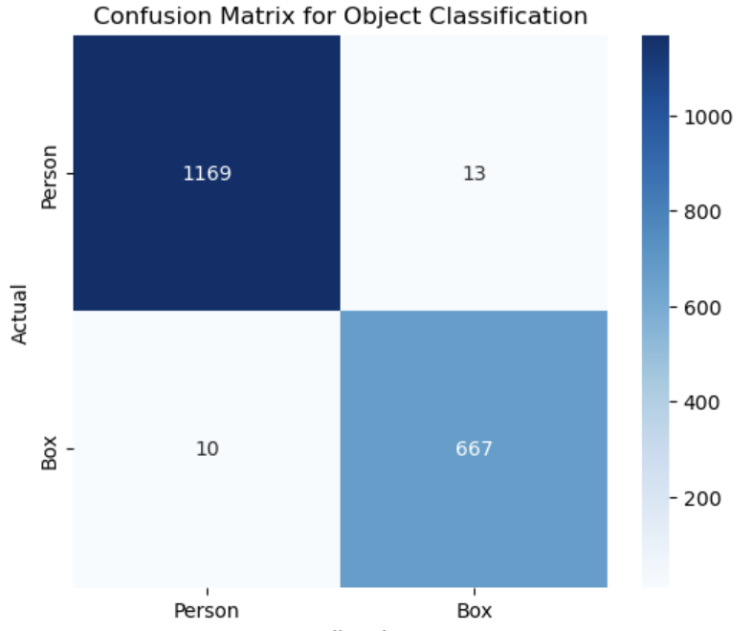
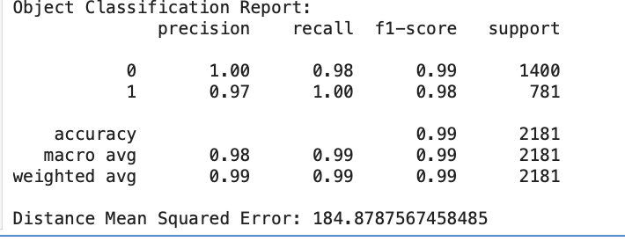
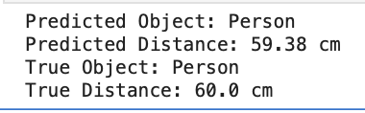
RESULTS
Object Classification report and Confusion Matrix analysis

Slide 12
CONCLUSION
This machine learning project based on horizontal perpendicular FIUS sensor detect the object type and the distance of that object by analysing the signal data found from the ultrasonic sensor. Several preprocessing techniques have been applied on the data like filtering and PSD for feeding this signal into the machine learning model. For detecting real world object eco positions and type of objects, this project gives a proper accuracy on the ultrasonic sensor signal data.

Slide 13
REFERENCES:

Slide 14
Thank You

